Slide 1
Group 2
Course Project
Sreeja Katanguri Kavya Reddy Basupalli Bhanu Nithin Yadav Manne Shivaram Reddy Vudumuala Nithin Reddy Muduganti

Slide 2
Introduction
In order to encourage reinvestment in housing, neighborhoods, commercial corridors, business development, and education and workforce development in St. Petersburg, the South St. Petersburg Community Redevelopment Area (CRA) was established in 2015.
The city wants to comprehend past trends in public and private investments since 2015 because it is now creating a Commercial Corridor Planning Program to fund planning and infrastructure enhancements. In order to affect the city's investment plan in the targeted areas of interest, the initiative requires students to study and publish pertinent data.

Slide 3
Business Problem
Analyze the size of properties on the commercial corridors according to land size and the number of properties. & Analyze the impact of public investments, e.g., CRA grants, on properties in the corridor.

Slide 4
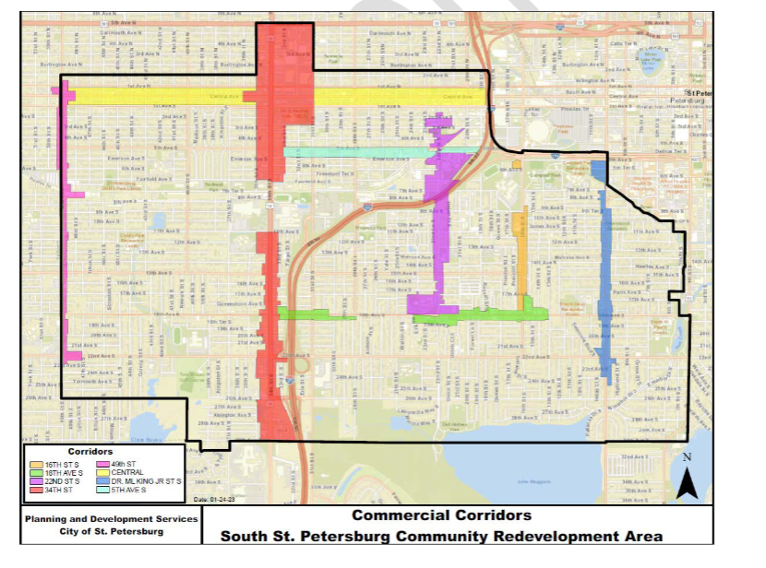

Slide 5
Business Research Questions.
a. What is the total land square footage/acreage of each commercial corridor? b. How many unique properties are on each commercial corridor? c. What percent of commercial properties on any the commercial corridor that took out building permits for renovations were awarded CRA Grants?

Slide 6
Total land square footage/acreage of each commercial corridor
The total land square value of each corridor is calculated and visualized. The 34th street corridor has the highest land footage value, followed by the central corridor, according to our analysis of the land square footage of each corridor.

Slide 7
Unique properties on each commercial corridor
Each business corridor contains a large number of properties, all of which have a different set of usage characteristics. After the study is complete, we may interpret the data to show that 34th Street has a lot of distinctive properties, which will provide the public with useful information about the properties they can invest in.

Slide 8
Percent of commercial properties on any the commercial corridor that took out building permits for renovations were awarded CRA Grants
When compared to the other city corridors, only a tiny number of commercial properties have received CRA subsidies. Here, the Central Avenue corridor has the highest percentage of CRA grants, followed by the 34th Street corridor. It will also give the general public useful information they may use to decide where and in which properties to invest in the future.

Slide 9
Our project’s major findings would give a brief understanding of CRA grants assigned to the newly permitted commercial corridors and the scope to understand the percentage of private and public investments in renovated land areas.
1.The first graph shows total land square footage for each commercial corridor.
2.The Second graph shows unique properties from the range 23 to 64.
3.The Third visual shows the highest percent of CRA Grants given to Central Ave Corridor.
Below is the link to our findings
Book1 | Tableau Public

Slide 10
Thank you

